Slide 1
GALLERIA DIAMOND JSWT AGENDA
Standing Agenda Support Slides

Slide 2
GALLERIA JSWT STANDING AGENDA
Opening Prayer (9:30 AM)
Review Team Rules (9:35)
Introductions (9:40)
Key Issues from Last Week (9:45)
Member Document Review of Training Presentation (9:50)
Member Status Updates (10:20)
Parking Lot Issues (10:50)
Networking Opportunities for the Week (11:10)
Future Meeting Assignments (11:15)
Meeting Quality Assessment (11:20)
Closure Prayer (11:25)
Meeting Close (11:30)

Slide 3
GALLERIA DIAMOND RULES (9:35-9:40)
Interact with open and honest communications
Show mutual respect and support for each other
Follow meeting efficiency guidelines
  Stay on topic
  Manage time
  No side-bar discussions
  Ensure effective closure of all topics)
Maintain confidentiality of information share during the meeting
Conduct self-assessments of effectiveness and take corrective action

Slide 4
INTRODUCTIONS (9:40-9:45)
Members (30 seconds)
  Who you are
  What you are looking for
  Remainder of elevator pitch if you want practice
Visitors (60 seconds for full elevator pitch)
  Who you are
  What you are looking for and the value you bring to the position
  Why you are the right person for the position
  What your goals are to deliver immediate value

Slide 5
LAST WEEK’S KEY ISSUES (9:45-9:50)
Last meeting +/∆
Nuggets from BJM
Unique interview questions
New tools for job search
Networking nuggets
Remember to park items for later review if needed

Slide 6
TRAINING ACTIVITY (9:50-10:20)
Member Document Review
  Don’t explain why you wrote your documents the way you did (0 minutes)
  Team silently reads marketing plan (5 minutes)
    Is it complete?
    Are the personal vision, objective, and target areas clear
    Comment only if the plan is incomplete
  Team reviews and provides feedback on resume (25 minutes)
    Does it reflect the vision and objectives in the marketing plan?
    Does it have a clear, concise summary aligned with the job objective?
    Are the limited few key competencies also aligned with the job objective?
    Do the selected accomplishments meet the S(O)AR requirements?
    Is the professional experience section concise and does it meet S(O)AR needs?
  Team reviews Executive Biography if time is available
or Training Presentation

Slide 7
STANDING TRAINING PRESENTATIONS
Process overview
Self Assessment
Achievement Statements
Company Research
Resume Development
Social Networking Profile
Metrics and Targets
Marketing Plan
Elevator Pitch
Business Networking
Controlling Your Campaign
Get What You Want
Cold Calling †
Speed Networking †

Slide 8
MEMBER STATUS UPDATES (10:20-10:50)
Limit to 3 minutes each – park extended discussion items
Landing date
Metrics/targets overview
Last week’s highlights
This week’s activities
Needs from team

Slide 9
ADDITIONAL AGENDA ITEMS
Parking Lot Issues (10:50-11:10)
  Prioritize and cover top issues only
Networking Opportunities for the Week (11:10-11:15)
  Confirm that list was received by members and guests
  Add additional opportunities if needed
Future Meeting Assignments (11:15-11:20)
  Facilitator, note taker, and time keeper at least two weeks out
  Document review dates for all new members
  Training needs with presenters and dates as appropriate
Meeting Quality Assessment (11:20)
Closure Prayer (11:25)
Meeting Close (11:30)

Slide 10
BACKUP MATERIALS

Slide 11
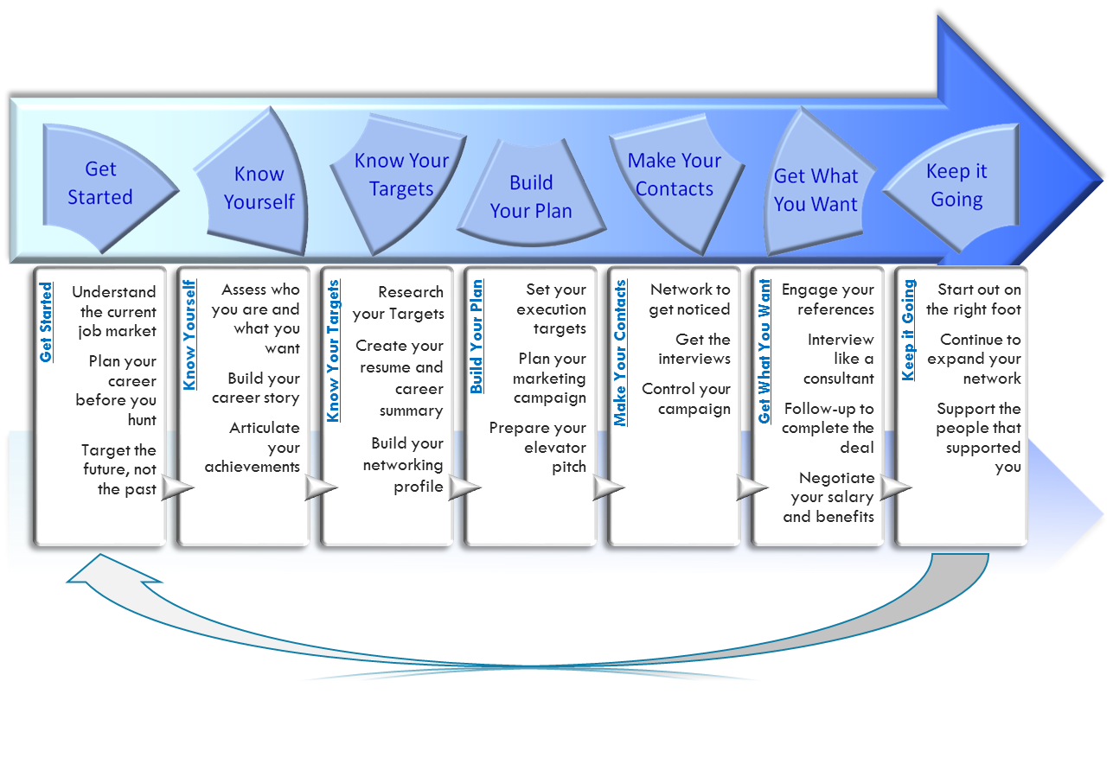
JOB SEARCH PROCESS OVERVIEW

